Slide 1
Superintendent’s Report Orange Public Schools “Good to Great”
Gerald Fitzhugh, II, Ed.D.
Superintendent of Schools
“ The Teaching Superintendent”
September 13, 2022
Focus Core Area Numbers 1- 4
District Goal Number 1-4 and All Sub Sections

Slide 2
Back to School Night Reminders
Name of School | Date for Back to School Night
Orange Preparatory Academy of Inquiry and Innovation | September 22, 2022 6:00 (Thursday)
Orange High School | September 29, 2022 6:00 pm (Thursday)
Rosa Parks Community School | September 27, 2022 6:00pm (Tuesday)
Scholars Academy | September 28, 2022 6:00 p.m.(Wednesday)
John Robert Lewis ECC | September 14, 2022 - 6:00pm (Wednesday)
Orange Early Childhood Center | September 29, 2022 6:00 p.m. (Thursday)
Central Elementary School | September 14, 2022 6:00 p.m. (Wednesday)
STEM Innovation Academy of the Oranges | September 21, 2022 6:00pm (Wednesday)
Heywood Avenue School | September 19, 2022 6:00pm (Monday)
Forest Street Community School | September 12, 2022 6:00pm (Monday)
Park Avenue School | September 20, 2022 6:00pm (Tuesday)
Twilight Program | September 29, 2022 6:00 PM (Monday)
Lincoln Elementary School | September 15, 2022 6:00pm (Thursday)
Oakwood Avenue Elementary School | September 26, 2022 6:00 PM (Monday)
Cleveland Street School | September 13, 2022 6:00 PM (Tuesday)

Slide 3
Hispanic Heritage Month Begins on September 15th
As you are aware, Hispanic Heritage Month began on September 15, 2022, and will conclude on October 15, 2022. All schools will have a hosting of activities to celebrate the Hispanic culture. Please be on the look out for these events so you can be a part of them. A little history about Hispanic Heritage Month: Hispanic Heritage Month actually began as a commemorative week when it was first introduced in June of 1968 by California Congressman George E. Brown. The push to recognize the contributions of the Latinx community had gained momentum throughout the 1960’s when the civil rights movement was at its peak and there was a growing awareness of the United States’ multicultural identities. On September 14, 1989, President George H.W. Bush who had been a sponsor of the original Hispanic Heritage Week resolution while serving in the House of Representatives in 1968 became the first president to declare the 31-day period from September 15th to October 15th as National Hispanic Heritage Month.

Slide 5
Mock Trial Program at the Orange Township Courthouse (Saturday, September 10, 2022)
On Saturday, September 10, 2022, several students from STEM Innovation Academy of the Oranges and Orange High School participated in the City of Orange’s Mock Trial Program. Thank you to Mayor Dwayne Warren, Esq. and Councilwoman at Large Adrienne Wooten for inviting our students. The students were quite engaged in the case presented and were able to strategically create arguments for and against the topic of exploration. Critical thinking skills were employed and our students were able to effectively articulate with fidelity. Way to go students!

Slide 6
Honors Biology, Honors Chemistry, Honors Environmental Science, Honors Physics, & AP Chemistry
Curricular Resources via Savvas Learning Company
David Scutari
Executive Director, Office of STEM-Focused Learning
September 13, 2022

Slide 7
Why now?
The return to in-person instruction has provided additional insights into the instructional needs of staff and learning needs of students
Selecting curricular resources and implementing a new curriculum is an opportunity to foster cohesion, trust, and professional learning, as well as to assess and respond to interests and needs (Joshua Starr, To Improve the Curriculum, engage the whole system)

Slide 8
What was the Process?
RFP issued in July 2022
Sub-committee convened to review submissions using guidelines outlined in RFP and select top 3 vendors
Top 3 vendors invited to present and unpack the curricular resources to full committee.
(McGraw Hill; Bedford, Freeman, and Worth Publishing; and Savvas Learning
Company)
Committee convened for instruction on use of the EQuIP Rubric for Science
The committee probed each vendor’s materials during in depth Q&A session
Committee members completed assigned sections of EQuIP Rubric for Science
Open dialogue amongst committee members
The committee’s findings presented to Superintendent

Slide 9
Who was on the committee?
Representation from across title, grade level, and servicing of student sub-group
3 Teachers who service grades 9-12
1 Teacher Coach
2 Administrators
1 Executive Director, 1 Supervisor
Evaluation Materials
EQuIP Rubric for Science
New Jersey Student Learning Standards for Science
College Board Sample Syllabi

Slide 10
EQuIP Rubric for Science
The EQuIP Rubric for Science has three categories:
Category I: NGSS 3D Design
Category II: NGSS Instructional Supports
Category III: Monitoring NGSS Student Progress

Slide 12
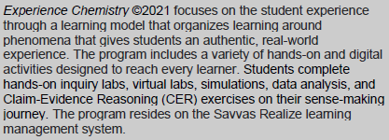

Slide 15
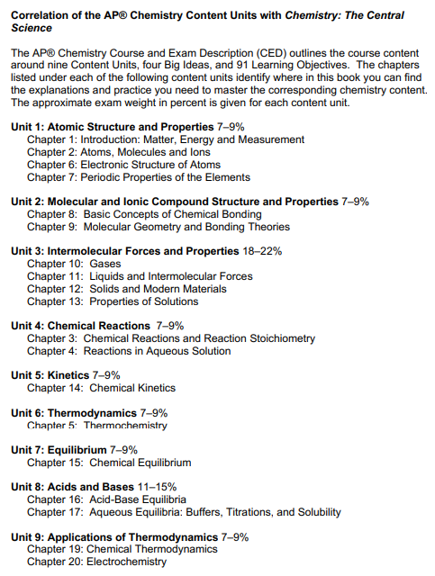
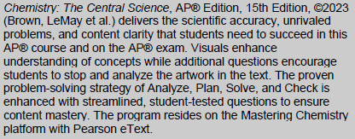

Slide 16
Savvas Learning Company Key Features
Each solution features interdisciplinary and applied approaches that focus on alignment to the New Jersey Student Learning Standards (NJSLS) and align to the Next Generation Science Standards (NGSS) and College and Career Readiness.
Savvas provides various language support options for their solutions, including eText,
translations, and assistive technologies for students who are visually and/or hearing impaired. This proposal includes language translation for text-to-speech.
Access to Virtual Labs (Honors Biology)
Access to Hands-on Labs and Experiences (Honors Chemistry, Honors Environmental Science, & Honors Physics)
Advanced Placement Support text (AP Chemistry)

Slide 17
Savvas Learning Company Key Features
Savvas programs include Savvas Realize™, an award-winning learning management system. The digital platform features program-specific resources, flexible agnostic resources, assessments, and interactive features to promote student engagement. With Savvas Realize, teachers have the flexibility to use a digital, print, or blended format in their classrooms.
Savvas, in partnership with Pearson, provides additional options in AP/Honors/Electives courses. Textbook purchase of Pearson programs includes Mastering with Pearson eText for online homework, tutorials, and assessment. The platform is designed to deliver a blended learning experience that is engaging and effective for students, easy for teachers to use and prepares students for college.
Additional titles accessible to teachers through digital platforms.
Integrates with Google Classroom

Slide 18
Savvas Learning Company
Some direct quotations from the Committee:
Great simulations – Virtual labs that allow you to tap into those different sets of learners
Everything in one spot, lesson plan, standards, assignments, banks of questions, etc.
You can assign content to students from other subjects
Text incorporated all 3 dimensions
The mastery questions are at a high level of complexity
Different lab options help students to interact with the text
Chapters have formative assessments to test students’ understanding
Assessments are designed for student self-assessment
Science and Engineering Practices are referenced throughout the chapters
Experience Physics has correlation page of SEP, CCC, and DCI

Slide 19
Savvas Learning Company
Some direct quotations from the Committee:
Logical progression of content
Many opportunities for formative assessment
Active student work experiences - tapping into all modalities
5E Model aligned and outlined in the teacher edition
Culturally relevant questions
Anchoring phenomenon, investigative phenomenon, and everyday phenomenon
Teachers can take a lot of the resources that they have in their Google Drive and add it to their Realize platform and organize the items by lesson
There is an English language development section in the teacher’s resources

Slide 20
What does it cost?
Student Materials – Costs vary per student edition ~ $38,669
Teacher Materials – Teacher editions ~ Free
– Lab Materials
Honors Env. Sci and AP Chem ~ Identified and purchased separately
Honors Bio ~ Included above in student edition pricing (Virtual Labs)
Honors Chem and Honors Phys ~ $49,820
Total ~ $105,496
Additional Costs – Shipping ~ $7,257
– Professional Development ~ $9,750

Slide 21
AP Biology, AP Environmental Science, & AP Physics
Curricular Resources via Bedford, Freeman, and Worth Publishing
David Scutari
Executive Director, Office of STEM-Focused Learning
September 13, 2022

Slide 22
Why now?
The return to in-person instruction has provided additional insights into the instructional needs of staff and learning needs of students
Selecting curricular resources and implementing a new curriculum is an opportunity to foster cohesion, trust, and professional learning, as well as to assess and respond to interests and needs (Joshua Starr, To Improve the Curriculum, engage the whole system)

Slide 23
What was the Process?
RFP issued in July 2022
Sub-committee convened to review submissions using guidelines outlined in RFP and select top 3 vendors
Top 3 vendors invited to present and unpack the curricular resources to full committee.
(McGraw Hill; Bedford, Freeman, and Worth Publishing; and Savvas Learning
Company)
Committee convened for instruction on use of the EQuIP Rubric for Science
The committee probed each vendor’s materials during in depth Q&A session
Committee members completed assigned sections of EQuIP Rubric for Science
Open dialogue amongst committee members
The committee’s findings presented to Superintendent

Slide 24
Who was on the committee?
Representation from across title, grade level, and servicing of student sub-group
3 Teachers who service grades 9-12
1 Teacher Coach
2 Administrators
1 Executive Director, 1 Supervisor
Evaluation Materials
EQuIP Rubric for Science
New Jersey Student Learning Standards for Science
College Board Sample Syllabi

Slide 25
EQuIP Rubric for Science
The EQuIP Rubric for Science has three categories:
Category I: NGSS 3D Design
Category II: NGSS Instructional Supports
Category III: Monitoring NGSS Student Progress

Slide 27
Biology for the AP Course (First edition) Key Features
Follows the AP® Biology Course and Exam Description
The organization and content of the book follows the course framework. Teachers can progress through the year without having to determine what content should be covered. The book weaves the Big Ideas throughout, building a deep network of connections across course content. The eight units match the units of the Course and Exam Description (CED) for easy alignment with the course and resources.
Easy-to-use modular organization
A modular organization pulls together content and AP® Exam practice into brief 1- to 2-day lessons. Shorter modules help students absorb the information without being overwhelmed and help you to more easily pace your Course.
Learning goals are listed at the beginning of each module to focus your students' reading and guide their comprehension. Bulleted summaries conclude the modules, highlighting key takeaways that students should master before moving on to the next module.
Four detailed in-text tutorials
Longer Tutorials presented throughout the book provide comprehensive explanations of
statistics, growth equations, probability, and graphing skills used throughout the course. The
tutorials are a great review tool. Tutorials also point you to relevant Analyzing Statistics and
Data boxes for additional practice.
AP® Exam Tips
Written by two former chief readers, AP® Exam Tips in each module highlight key content
students are likely to see on the exam and provide guideposts on concepts they should be sure to review.

Slide 28
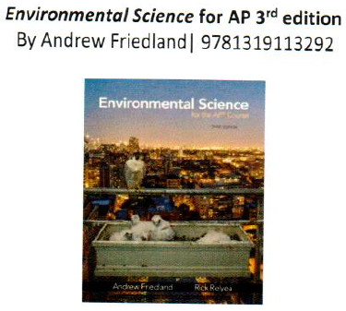

Slide 29
Environmental Science for AP 3rd edition Key Features
This program is fully aligned with the NEW 2019 AP Environmental Science course framework.
Module Structure: Chapters are divided into short Modules to help keep content manageable. Each module opens with a brief description of the topics covered.
Chapter Opening Case Study: An intriguing case study begins each chapter and asks students to think about the environmental challenges and trade-offs that are introduced. The subjects of these studies often will spark spirited class discussion.
Do the Math: Among the biggest challenges on the AP® Environmental Science Exam are questions that ask you to solve environmental science math problems. Every chapter contains between 1-3 "Do the Math" boxes which present math skills needed for the Exam. After showing students how to work a problem, they have an opportunity to practice on their own with "Your Turn.
Prepare and practice for the AP Environmental Science Exam: A practice exam at the end of each chapter can be used for in-class assessment or homework. The practice exams familiarize students with AP®-style questions all year. The practice exam includes multiple-choice questions and free-response questions. Many of the questions require analysis of data or visual material.
Cumulative AP Environmental Science Practice Exam: The text offers two cumulative exams that are fully aligned to the 2019 AP CED with 80 multiple-choice questions and 3 free- response questions. These exams, located at the end of the book, match the actual AP Environmental Science exam in length and scope.
Working Toward Sustainability: This feature, located at the end of each chapter describes people and organizations that are making a difference. The feature includes critical thinking questions that give students a chance to hone their critical thinking and writing skills.
AP Exam Tips are scattered throughout each chapter to prepare for the exam by making sure students know key information that is likely to appear on the exam.

Slide 30
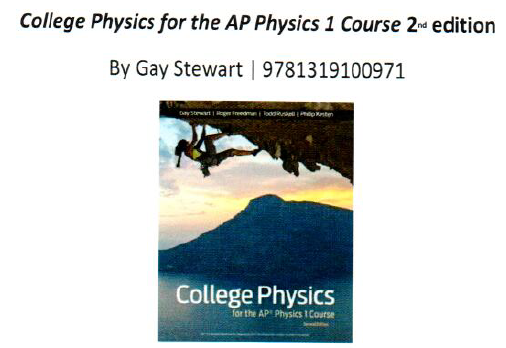

Slide 31
College Physics for the AP Physics 1 Course 2nd edition Key Features
Real-world Case Studies at key content areas throughout the textbook invite students into the world of physics by asking them a question and showing them how using physics answers it. Scaffolded Art and equations provide a visual narrative in the form of word bubbles that clearly break down important physics topics.
Now Work notes at the end of each Worked Example connect students to related problems in The Takeaway, the end-of-section review.
Powerful AP* Practice & Concept Review
AP® Exam Tips, written by a former Chief Reader, offer hints and tips on how to succeed on the AP® Physics 1 Exam.
AP® Skill Building problems appear in each Takeaway
AP® Extending Skills question appears in the end-of-chapter content, providing students with an opportunity to extend the AP® skills they've been developing throughout the chapter to a real-world situation (designed to be done as group work or as an individual challenge problem) AP® Practice Problems at the end of each chapter allow students to practice solving the types of problems that they'll see on the AP* Physics 1 exam.
You Will learn To boxes at the start of each chapter highlight chapter learning goals that provide students with the scope of study. The same goals align with What Did You
Learn? boxes that sit after the last section and tie each learning goal to the relevant chapter section, worked example, and end-of-section practice problem.

Slide 32
Bedford, Freeman, and Worth Publishing
Some direct quotations from the Committee:
Textbooks from this company are designed for the AP exams
Chapters provide students with opportunities to express, clarify, justify, interpret, and represent their ideas
Chapters provide building opportunities for students
Chapters engage students
Highly beneficial for 1st year AP teachers
There are different forms of assessment
BFW is AP aligned
Case Study for each unit
Appropriately leveled

Slide 33
Bedford, Freeman, and Worth Publishing
Some direct quotations from the Committee:
Each section has a “What do you think?” scenario applying concepts to other disciplines
Sapling Plus generates reports for teaching
Systems and models are used throughout
Lesson targets are outlined at the beginning of each module
They make an effort to design the books so that students can be best prepared for the AP exams
Breaks down the amount of time that the teacher should spend on each topic
Learning curve questions allow students to review big ideas/concepts and they are incentivized to answer questions correctly

Slide 34
What does it cost?
Student Materials – Costs vary per student edition ~ $16,585
Teacher Materials – Teacher editions ~ Free (Online)
– Lab Materials ~ Identified and purchased separately
Total ~ $17,414
Additional Costs – Shipping ~ $829
– Professional Development is included in cost

Slide 35
Algebra I, Geometry, and Algebra II Illustrative Mathematics
Curricular Resource via Kendall Hunt Publishing
David Scutari
Executive Director, Office of STEM-Focused Learning
September 13, 2022

Slide 36
Why now?
The return to in-person instruction has provided additional insights into the instructional needs of staff and learning needs of students
Selecting curricular resources and implementing a new curriculum is an opportunity to foster cohesion, trust, and professional learning, as well as to assess and respond to interests and needs (Joshua Starr, To Improve the Curriculum, engage the whole system)

Slide 37
What was the Process?
RFP issued in July 2022
Sub-committee convened to review submissions using guidelines outlined in RFP and select top 2 vendors
Top 2 vendors invited to present and unpack the curricular resources to full committee.
(Open Up Resources Mathematics Vision Project and Kendall Hunt Publishing
Illustrative Mathematics)
Committee convened for instruction on use of the Instructional Materials Evaluation Tool (IMET)
The committee probed each vendor’s materials during in depth Q&A session
Committee members completed assigned sections of IMET
Open dialogue amongst committee members
The committee’s findings presented to Superintendent

Slide 38
Who was on the committee?
Representation from across title, grade level, and servicing of student sub-group
3 Teachers who service grades 9-12
2 Teacher Coaches
4 Administrators
1 Executive Director, 3 Supervisors
Evaluation Materials
Achievethecore.org Instruction Materials Evaluation Tool (IMET)
New Jersey Student Learning Standards for Mathematics
Standards for Mathematical Practice
Major Work of the Course

Slide 39
Instructional Materials Evaluation Tool
The IMET attends to the following Non-negotiables and Alignment criteria.
Non-Negotiable & Alignment Criteria
New Jersey Student Learning Standards
Focus and Coherence
Rigor and Balance
Standards for Mathematical Practice
Access to the Standards for All Students

Slide 40
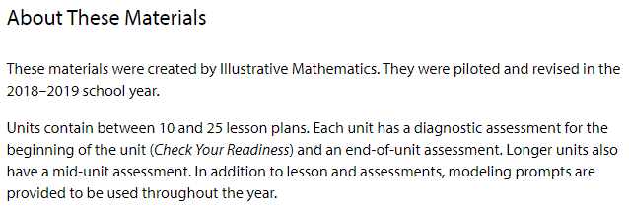
Illustrative Mathematics via Kendall Hunt Publishing

Slide 41
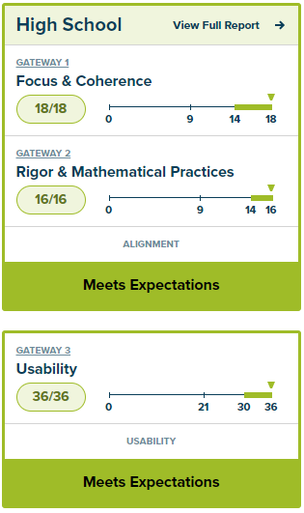
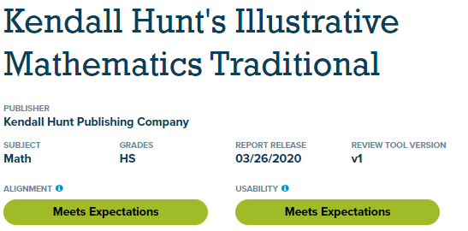
Illustrative Mathematics via Kendall Hunt Publishing

Slide 42
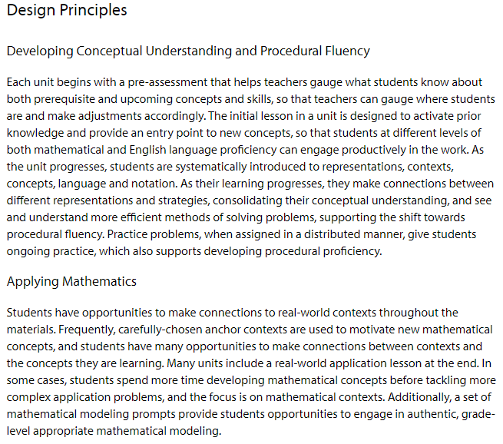
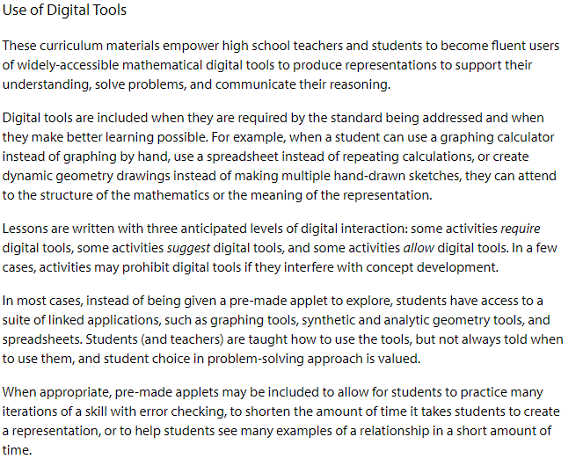
Illustrative Mathematics via Kendall Hunt Publishing

Slide 43
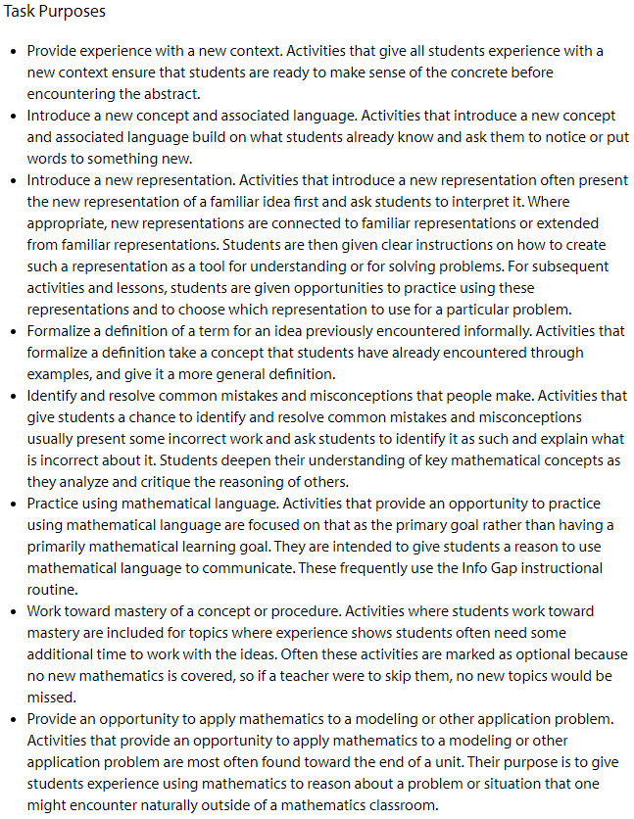
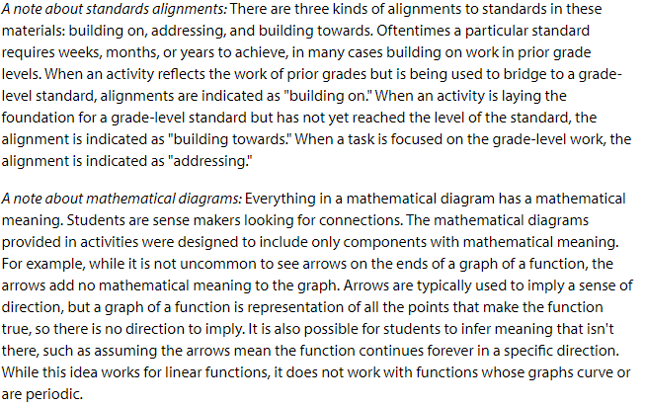
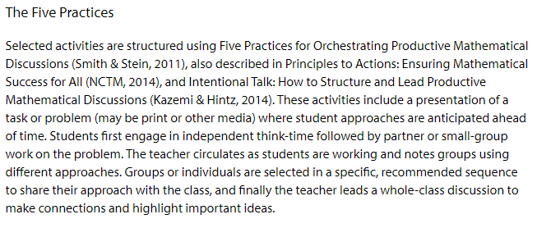
Illustrative Mathematics via Kendall Hunt Publishing

Slide 44
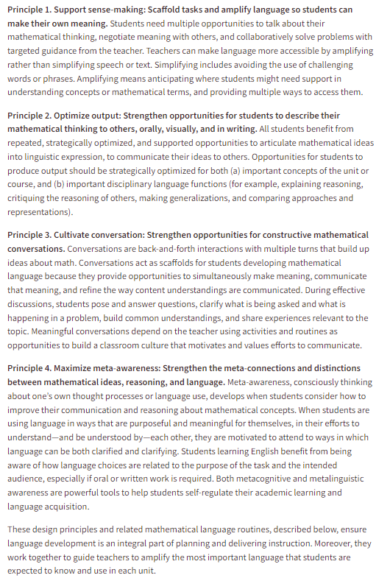
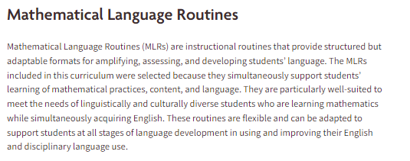
Illustrative Mathematics via Kendall Hunt Publishing

Slide 45
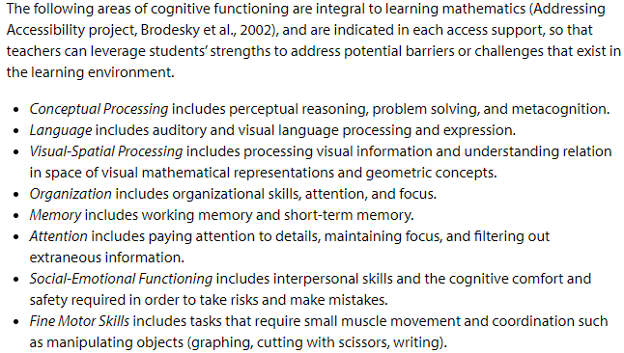
Illustrative Mathematics via Kendall Hunt Publishing

Slide 46
Illustrative Mathematics via Kendall Hunt Publishing
Some direct quotations from the Committee:
Alignment with prerequisite standards – all standards aligned
Rigorous lessons and problem sets as well as questioning to facilitate deeper thinking around concepts
Provides rubrics for evaluating student responses on assessments
The problems are of very high quality and leave lots of room for good mathematical discourse
The warm-ups elicit the use of prior understandings and correct use of vocabulary
Assessments looks like NJSLA questions
Assessments have problems that address the standards and make students think
The assignments that accompany the lessons are directly related to conceptual understanding
Majority of the activities engage students in constructing viable arguments
A lot of problems have procedural and conceptual components together

Slide 47
Illustrative Mathematics via Kendall Hunt Publishing
Some direct quotations from the Committee:
Students model with both math concepts as well as real world scenarios
Assignments lend themselves to reasoning while not detracting from the math skills
Vocabulary and math language are embedded in the lessons
Many of the questions ask the students to explain their reasoning/show work/ compare answers
High-quality conceptual problems and discussions are built within each lesson
The progress towards fluency and procedural skills is interwoven within the student’s developing conceptual understanding
There were ample opportunities for students to engage in multi-step contextual problems to develop the mathematics of the course
Activities, problem sets, and assessments require students to continuously engage in repeated reasoning

Slide 48
What does it cost?
Student Materials – $25 per student edition ~ $27,325
– $19 per Algebra 1 Supports ~ $6,703
Teacher Materials – $75 per teacher edition ~ $2,700
– $45 per Algebra 1 Supports ~ $720
– Class Kits vary by course ~ $7,747
Total ~ $67,522
Additional Costs – Shipping ~ $6,327
– Professional Development ~ $16,000

Slide 49
The Orange Public Schools Facilities Update
Mr. Edwin Vasquez
Manager of Facilities
September 13, 2022
Focus Core Area Number 1-4
District Goal Number 3

Slide 50
District facility Maintenance & Custodial Services Updates
Thorough Cleaning Daily and Disinfecting of all touch points in the building (examples include but not limited to: Door handles, bathrooms, entrances, and exits, bannisters)
Minor and major repairs on air conditioning units through out the district
Walk-throughs of all school district facilities
PCI and District Meetings based on Updates related to COVID-19 mandates and expectations
Summer Cleaning has been completed; monitoring of facilities to maintain the summer work is now in progress

Slide 51
Facility Updates
In the month of August, we continued our summer cleaning in preparation of the new school year.
The district has tackled some big projects this summer, from repairing roofs to replacing gym floors.

Slide 52
Facility Updates
Park Avenue School – the two circulating pumps were replaced in preparation for the winter months.
Heywood Avenue School - The gymnasium floor was replaced; repairs of sidewalks and exterior stairs are still being repaired.
Orange High School – The Amphitheater was repaired and is in readiness
Orange Preparatory Academy - All restrooms were remodeled and the interior building was painted.
Lincoln Avenue School – One chiller was repaired. We are awaiting parts to repair the air handlers.
Administration Building – The lower roof was replaced.
John Robert Lewis Early Childhood Center – The new playground was installed
Forest Street School - The old boiler was removed and the preparation on new boiler installed was conducted.

Slide 53
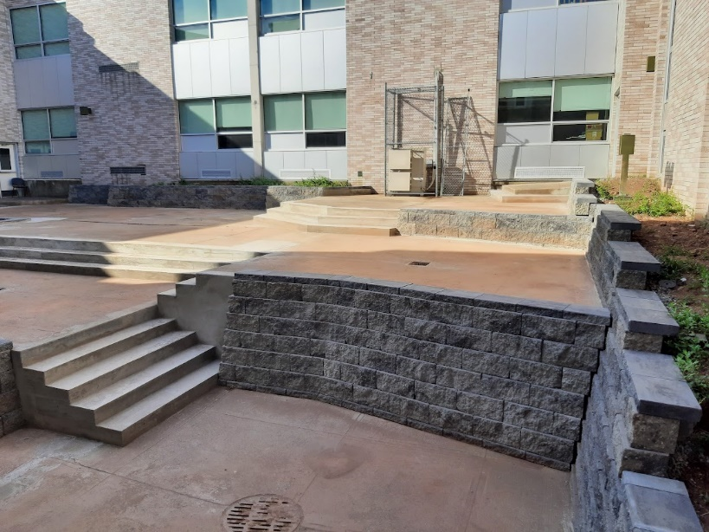
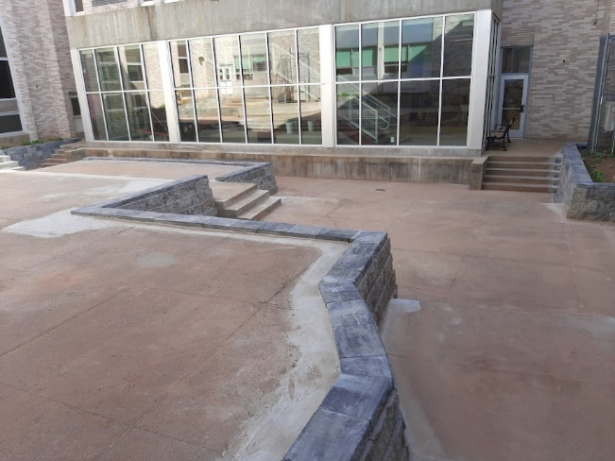
Orange High School
New Amphitheater

Slide 54
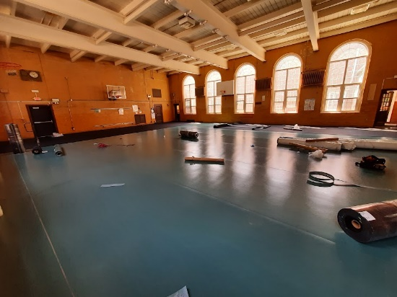
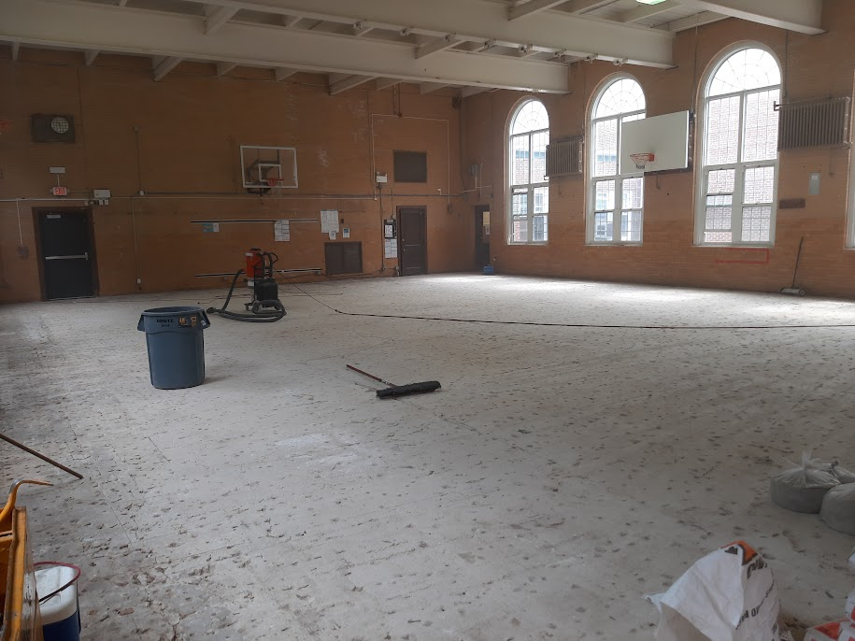
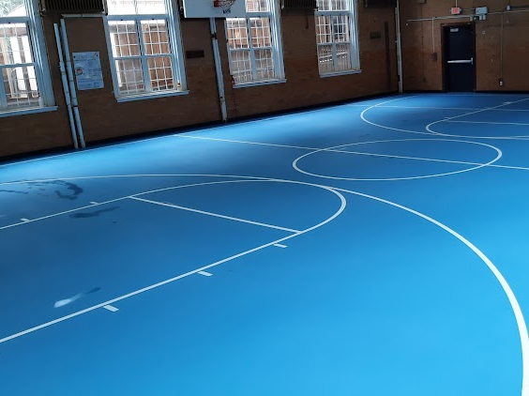
Heywood Avenue School
New Gymnasium Floor

Slide 55
John Robert Lewis Early Childhood Center
New Playground

Slide 56
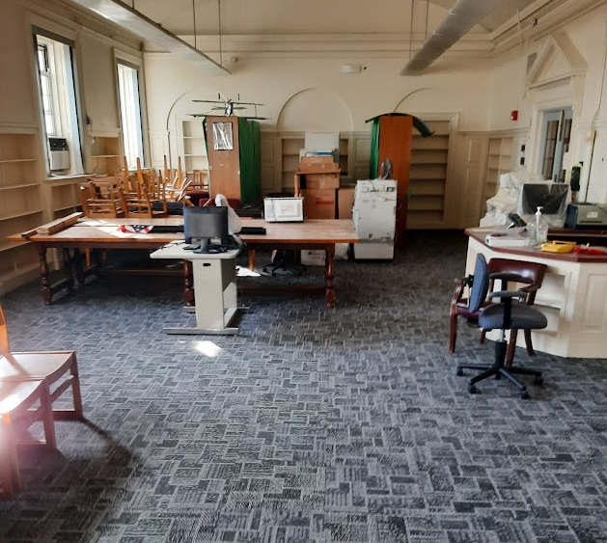
Orange Preparatory Academy Of Inquiry and Innovation
Recarpeted the Media Center

Slide 57
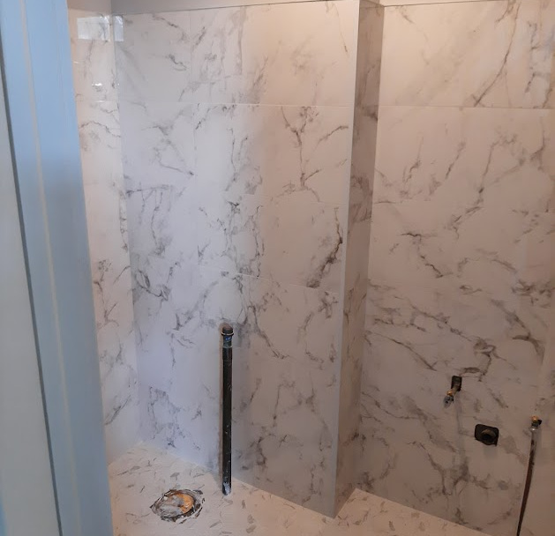
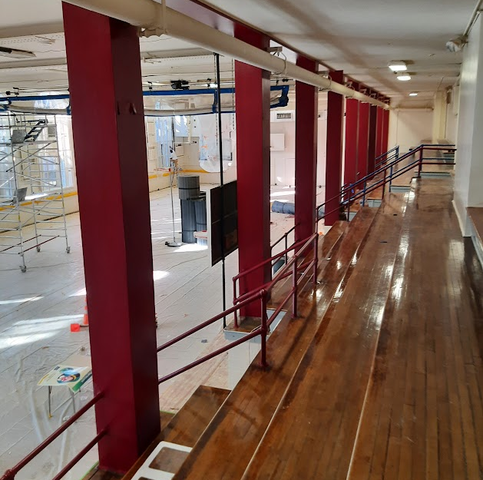
Orange Preparatory Academy of Inquiry and Innovation
Few pictures of the restroom being remodeled, stairwells being painted, and the gymnasium being painted. The anticipated date of usage of the gymnasium will be September 24th as the flooring is the last component of the project. The flooring was a School Development Authority Project.

Slide 58
In the Month of September 2022
The team and I will continue to meet with the Schools Development Authority and Terminal Construction alongside the School Business Administrator, Mr. Jason Ballard in order to keep the district up to date with the ongoing progress of the Orange HS renovation project.

Slide 59
Reminder from the Office of Facilities
We will continue to update the community, staff, and Board of Education Members of all progress.
The health and safety of staff and students are at the apex of all facilities undertakings.

Slide 60
Reminder: The Orange App Have you signed up? You know I am sending blasts out for folks to sign up…Stay Tuned

Slide 61
Reminder: School Times for Staff and Students SY 2022-2023
School Level | Arrival Time for Students | Arrival Time for Staff | End Time for Students | End Time for Staff
Elementary Level (Including Pre-Kindergarten) | 8:30 AM | 8:20 AM | 3:00 PM | 3:10 PM
Orange High School | 8:20 AM | 8:05 AM | 2:40 PM | 2:55 PM
Orange Preparatory Academy of Inquiry and Innovation | 8:25 AM | 8:15 AM | 2:50 PM | 3:05 PM
STEM Innovation Academy of the Oranges | 8:20 AM | 8:15 AM | Mondays 2:20 PM for Teacher Professional Development Tues – Fri 3:30 PM | 4PM* *includes stipend
Twilight Program | 3:30 PM* *3:00 PM - lunch | 3:00 PM | 7:30 PM | 7:30 PM

Slide 62
Orange Public Schools Social Media
Social Media Hashtags:
#GoodtoGreat
#MovingintoGreatness
#OrangeStrong
Follow us:
- Orange Public School District
- @ops_district
- opsdistrict
- Orange Public School District
Notes:
Shanell
SL - Our education system was not designed to educate everyone equally; it is the result of “inequity by design.”

